Slide 1

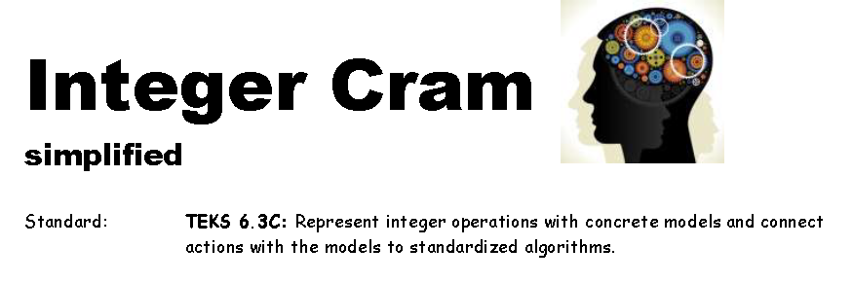
Slides for Integer cram
Created by Glenna Tabor for Tabor Team Members
© 2020 Glenna Tabor Resources, LLC

Slide 2
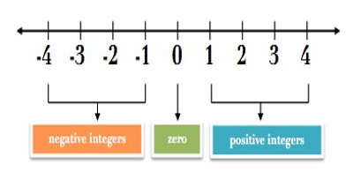
Before we begin, write down what you think you know about…
Integers
Combining Integers
© 2020 Glenna Tabor Resources, LLC

Slide 3


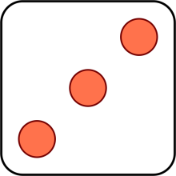


Slide 4
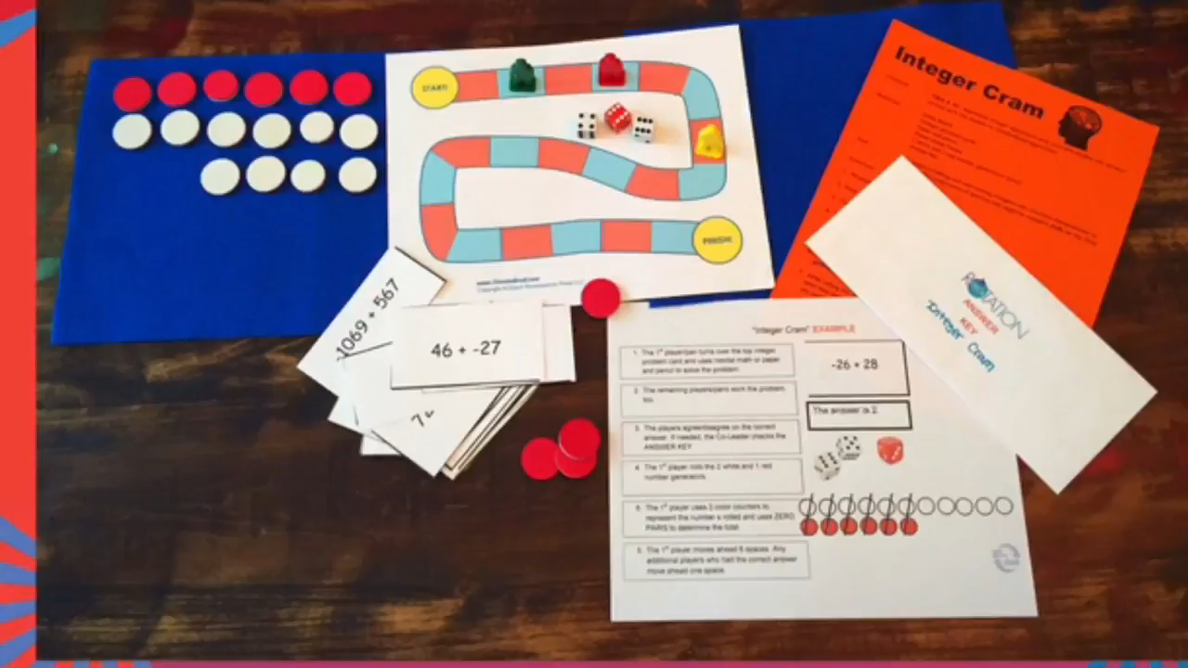
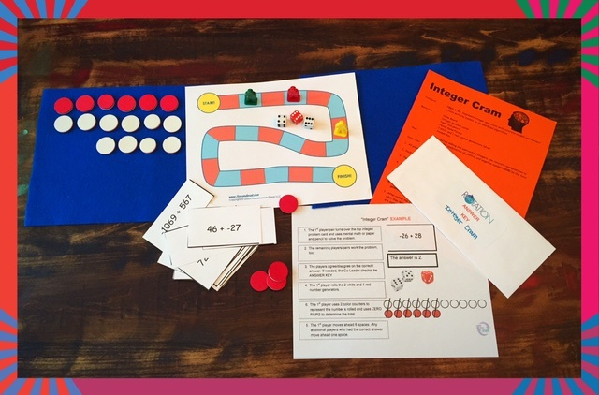
© 2020 Glenna Tabor Resources, LLC

Slide 5
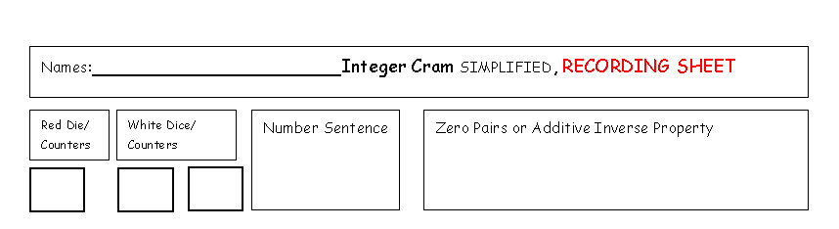
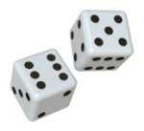


Play the game and record. If in virtual setting, send a scan or picture.
6 + 5 -6 = 5
6.3(C) Represent integer operations with concrete models and connect the actions to with the models to standardized algorithms
© 2020 Glenna Tabor Resources, LLC

Slide 6
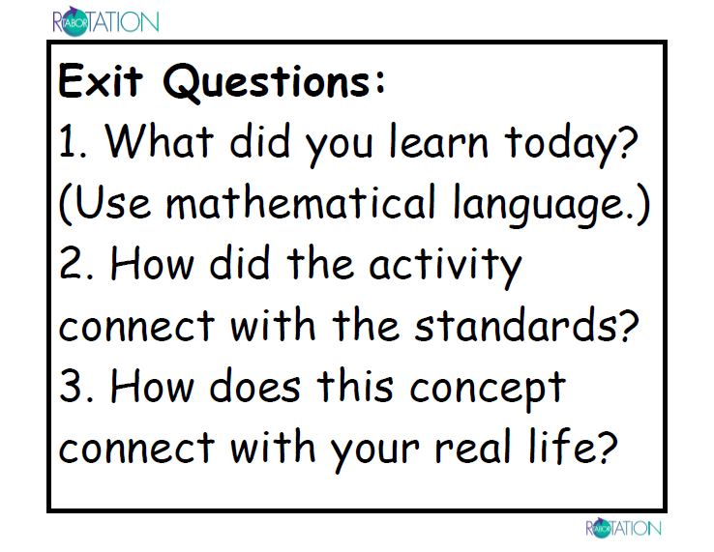
Write a math term we used.
© 2020 Glenna Tabor Resources, LLC

