Slide 1
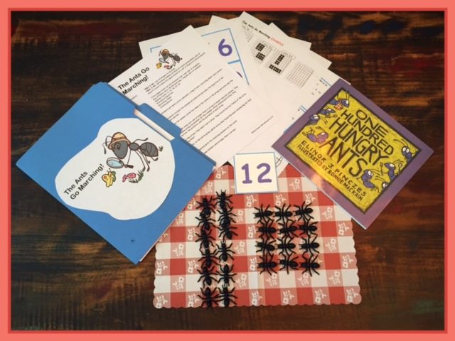
Slides for ANTS GO MARCHING-ARRAYS Created by Glenna Tabor for Tabor Team Members

Slide 2
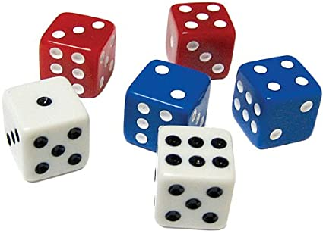
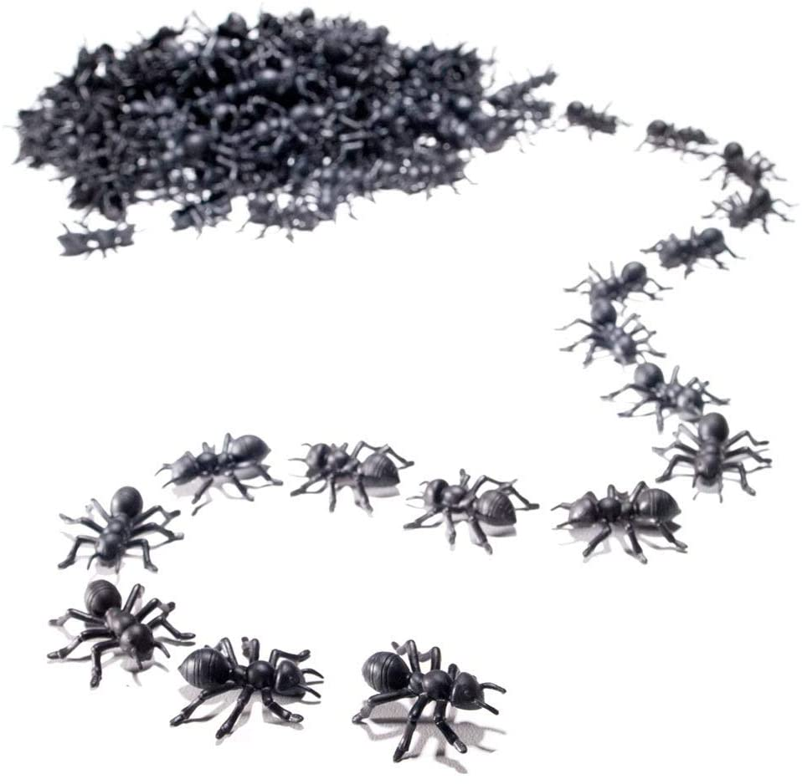
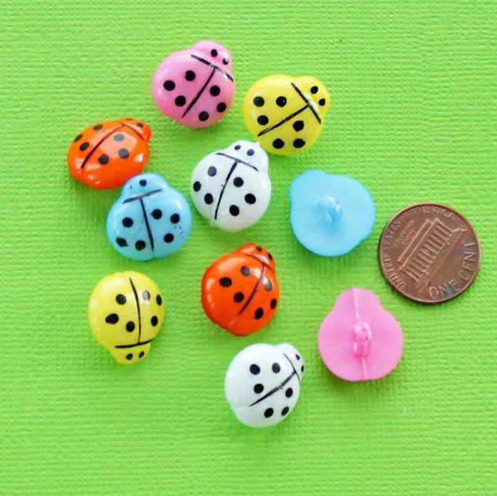
Here are some tools you could use.
© 2020 Glenna Tabor Resources, LLC

Slide 3
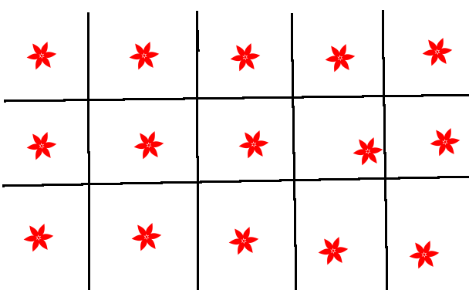
Standard: Find all factor pairs for a number and recognize the multiples.
© 2020 Glenna Tabor Resources, LLC

Slide 4
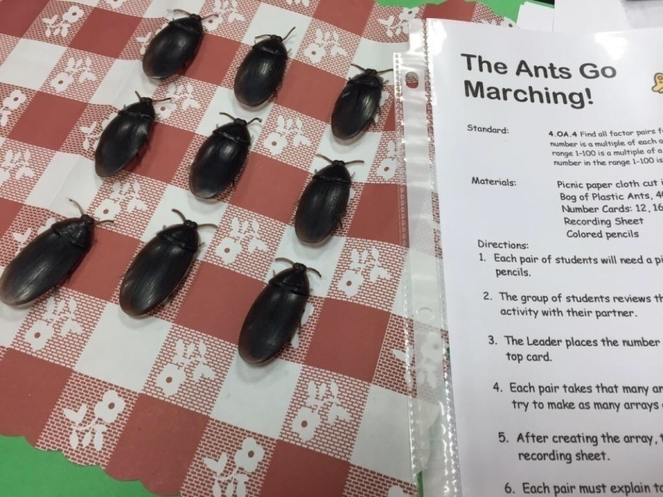
PRE-ASSESSMENT: Create as many different ways to arrange 18 dots as possible.
© 2020 Glenna Tabor Resources, LLC

Slide 5
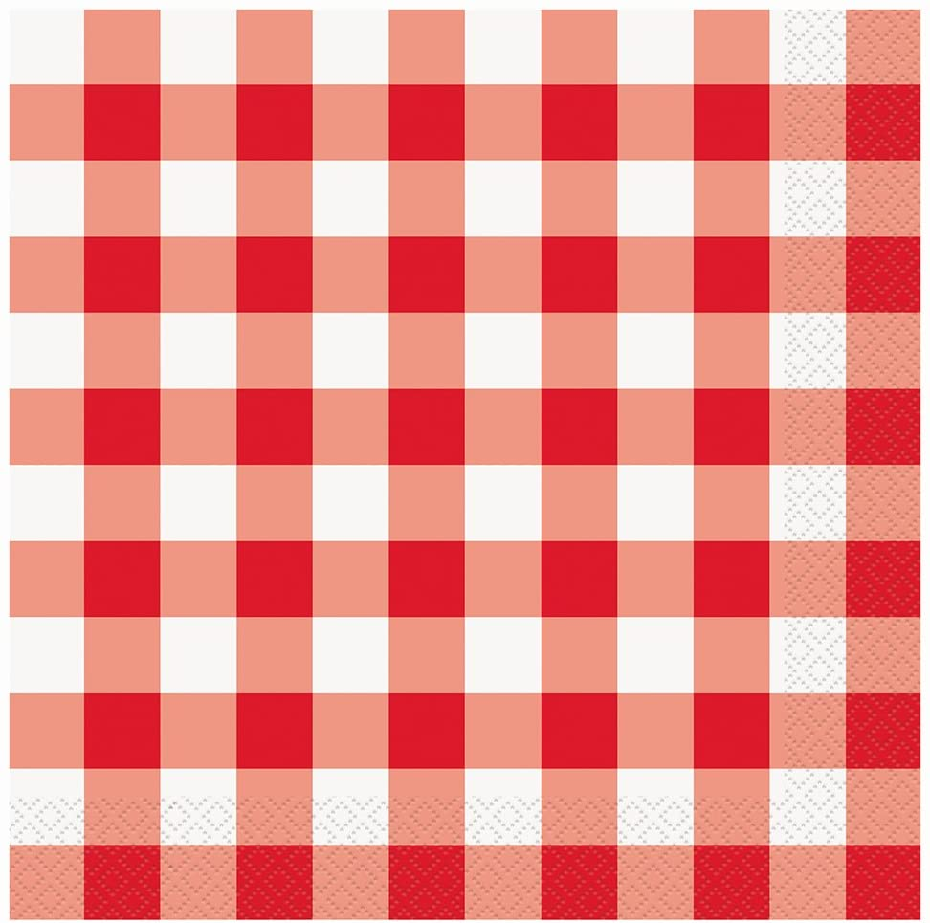
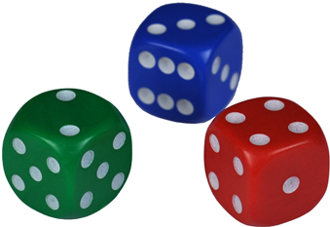
1. Put out a work mat.
2. Roll 3 number generators and add total all three to find the total number of ants to use.
3. Find as many different ways as you can to arrange the ants in equal rows & columns.
4. Record your ways on the grid paper and label the factors.
© 2020 Glenna Tabor Resources, LLC

Slide 6
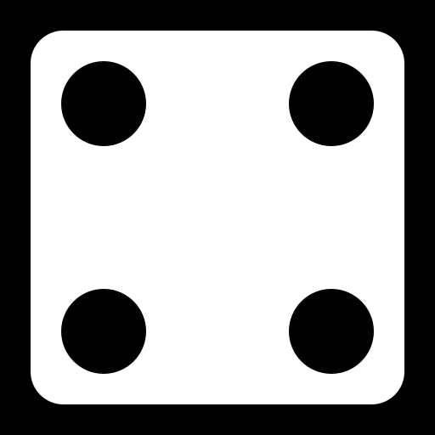
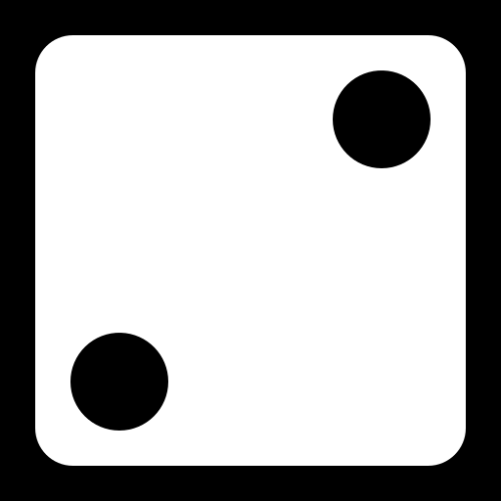
Let’s try one together.
© 2020 Glenna Tabor Resources, LLC

Slide 7
Watch a video to learn even more about how to play!

Slide 8
Play the game and record.

Slide 9
Write a math term we used.
How could you apply this skill in real life?

